Slide 1

CS6611 – CREATIVE AND INNOVATIVE PROJECT
ELECTION SENTIMENT ANALYSIS
Done by,
R A Nithish Kumar – 2021103548
Aravind Krishnan S – 2021103509
T V Pavishek – 2021103721

Slide 2
PROBLEM STATEMENT
Traditional methods like polls struggle to capture the real time pulse of public opinion during elections .
Social media offers a massive dataset , but analysing it efficiently is difficult due to volume , complexity and bias.
The proposal is to develop and apply advanced NLP techniques like sentiment analysis to automatically classify and analyse opinions expressed in election-related tweets.
Sentiment analysis can automatically classify opinions(positive,negative,neutral) expressed in election-related text, offering valuable insights.

Slide 3
OBJECTIVES
General objectives
Understanding public opinion
Predicting election outcomes
Enhancing democratic processes
Specific objectives
Identify and categorize the key issues driving public sentiment for each candidate or party.
Develop a sentiment analysis model that can accurately classify text data (e.g., tweets, news articles) as positive, negative, or neutral towards specific candidates or parties.
Analyze the volume of positive, negative, and neutral sentiment over time to identify trends in public opinion throughout the election cycle.

Slide 4
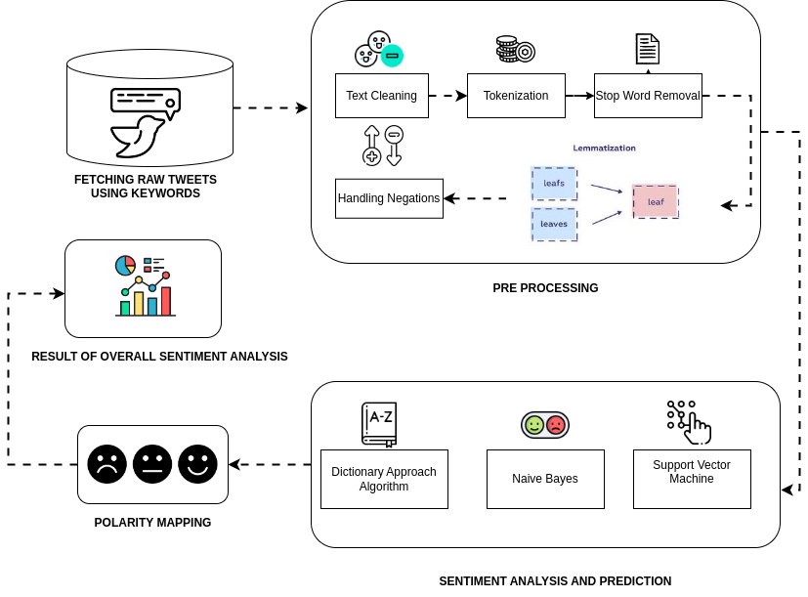
SENTIMENT ANALYSIS

Slide 5
Title | Methodology | Limitations
Li, G., Zheng, Q., Zhang, L., Guo, S., & Niu, L. (2020, November). Sentiment infomation based model for chinese text sentiment analysis. In 2020 IEEE 3rd international conference on automation, electronics and electrical engineering (AUTEEE) (pp. 366-371). IEEE. | This paper proposes a sentiment information based network model(SINM). We use Transfomer encoder and LSTM as model components. | These models rely heavily on the quality and size of the training data. If the training data doesn't accurately reflect the nuances of Chinese sentiment expression, the model's accuracy will suffer.
Woldemariam, Y. (2016, March). Sentiment analysis in a cross-media analysis framework. In 2016 IEEE international conference on big data analysis (ICBDA) (pp. 1-5). IEEE. | The pipeline includes the following components; chat room cleaner, NLP and sentiment analyzer. we use the apache-hadoop framework with its lexicon-based sentiment prediction algorithm and Stanford coreNLP library with the Recursive Neural Tensor Network (RNTN) model. | Sentiment can be expressed differently across media. A frowning emoji in text is a clear negative sign, but a frown in a video might indicate concentration or contemplation.
Ilmania, A., Cahyawijaya, S., & Purwarianti, A. (2018, November). Aspect detection and sentiment classification using deep neural network for Indonesian aspect-based sentiment analysis. In 2018 International Conference on Asian Language Processing (IALP) (pp. 62-67). IEEE. | On sentiment classification, we also compare two approaches of deep neural network. The first approach uses word embedding, sentiment lexicon and POS tags as the input vector, with bi-GRU based as the topology. The second one uses aspect matrix to rescale the word embedding vector as the input vector and convolutional neural network (CNN)based as the topology. | ABSA models require a large amount of high-quality Indonesian training data. This data needs to be labeled with both the aspects and their sentiment polarities.

Slide 6
Fujihira, K., & Horibe, N. (2020, September). Multilingual sentiment analysis for web text based on word to word translation. In 2020 9th International Congress on Advanced Applied Informatics (IIAI-AAI) (pp. 74-79). IEEE. | we design a multilingual sentiment analysis method based on word to word translation using a sentiment dictionary in arbitrary native language. We conduct a sentiment classification experiment for tweets in English, German, French, and Spanish. | Languages express sentiment in nuanced ways. Direct word-to-word translation often fails to capture these subtleties. Sarcasm, irony, and cultural references can be misinterpreted, leading to inaccurate sentiment classification
Wang, Z., Chong, C. S., Lan, L., Yang, Y., Ho, S. B., & Tong, J. C. (2016, December). Fine-grained sentiment analysis of social media with emotion sensing. In 2016 Future technologies conference (FTC) (pp. 1361-1364). IEEE. | This paper describes a social media analytics engine that employs a social adaptive fuzzy similarity-based classification method to automatically classify text messages into sentiment categories (positive, negative, neutral and mixed), with the ability to identify their prevailing emotion categories (e.g., satisfaction, happiness, excitement, anger, sadness, and anxiety). | Social media posts often contain ambiguous language, slang, sarcasm, and context-specific expressions that can be challenging for sentiment analysis algorithms to interpret accurately.

Slide 7
Reference:
https://ieeexplore.ieee.org/document/7821783
https://ieeexplore.ieee.org/document/9315668
https://ieeexplore.ieee.org/document/7509790
https://ieeexplore.ieee.org/document/8629181
https://ieeexplore.ieee.org/document/9430413

Slide 8
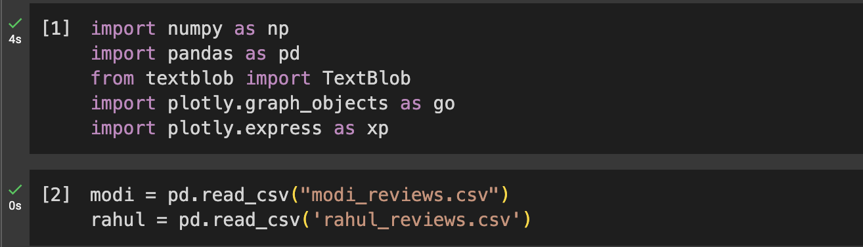
IMPLEMENTATION
Module 1 -Data Collection and Pre-processing
1. Import datasets
https://github.com/pavishek2004/CIP-project/blob/main/modi_reviews.csv
https://github.com/pavishek2004/CIP-project/blob/main/rahul_reviews.csv

Slide 9
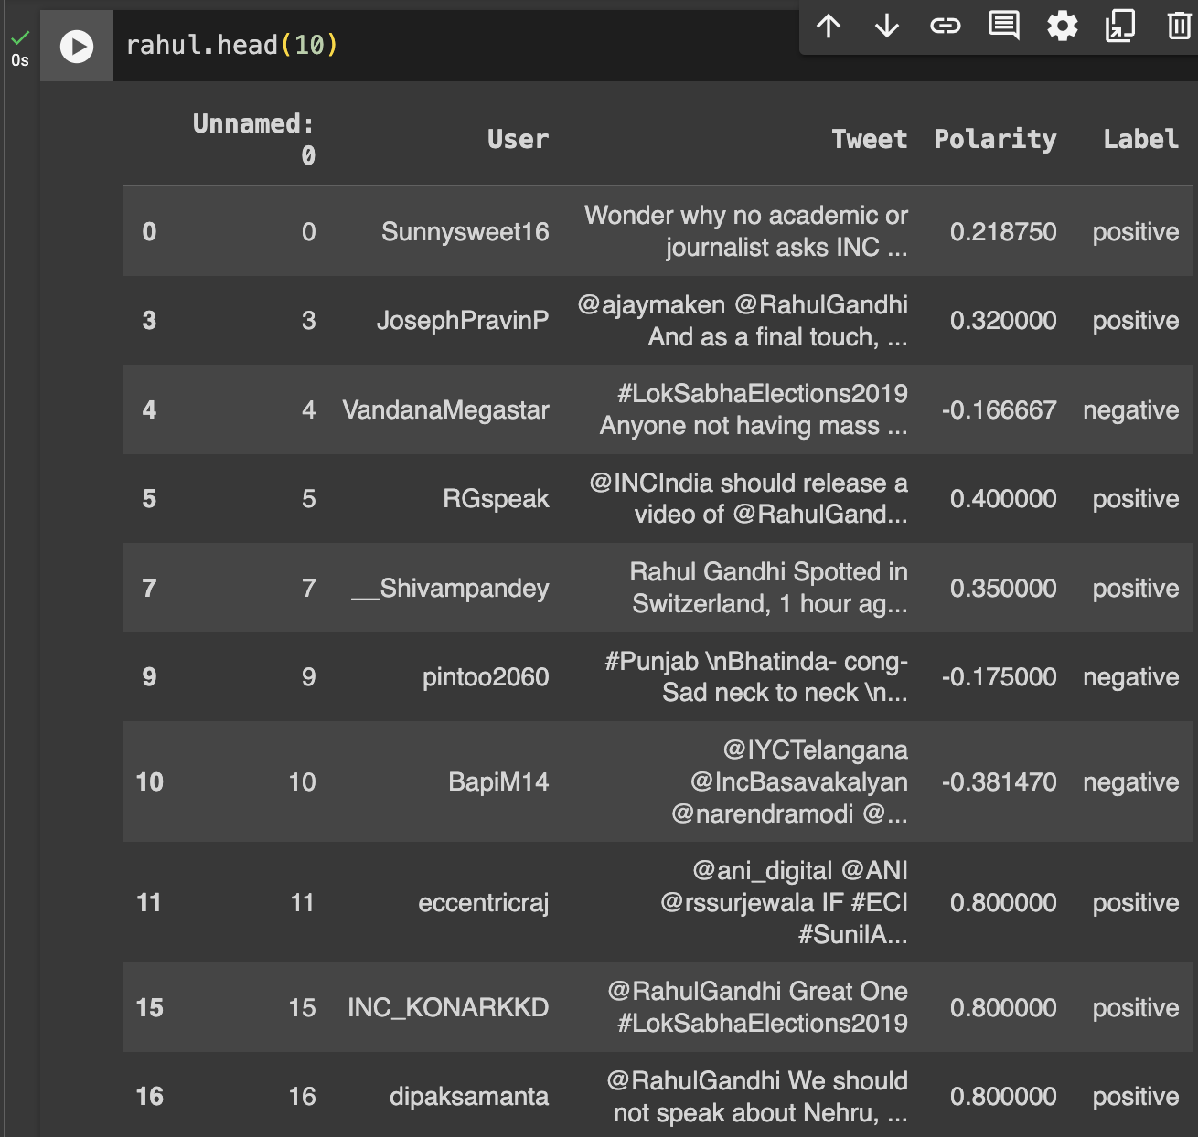
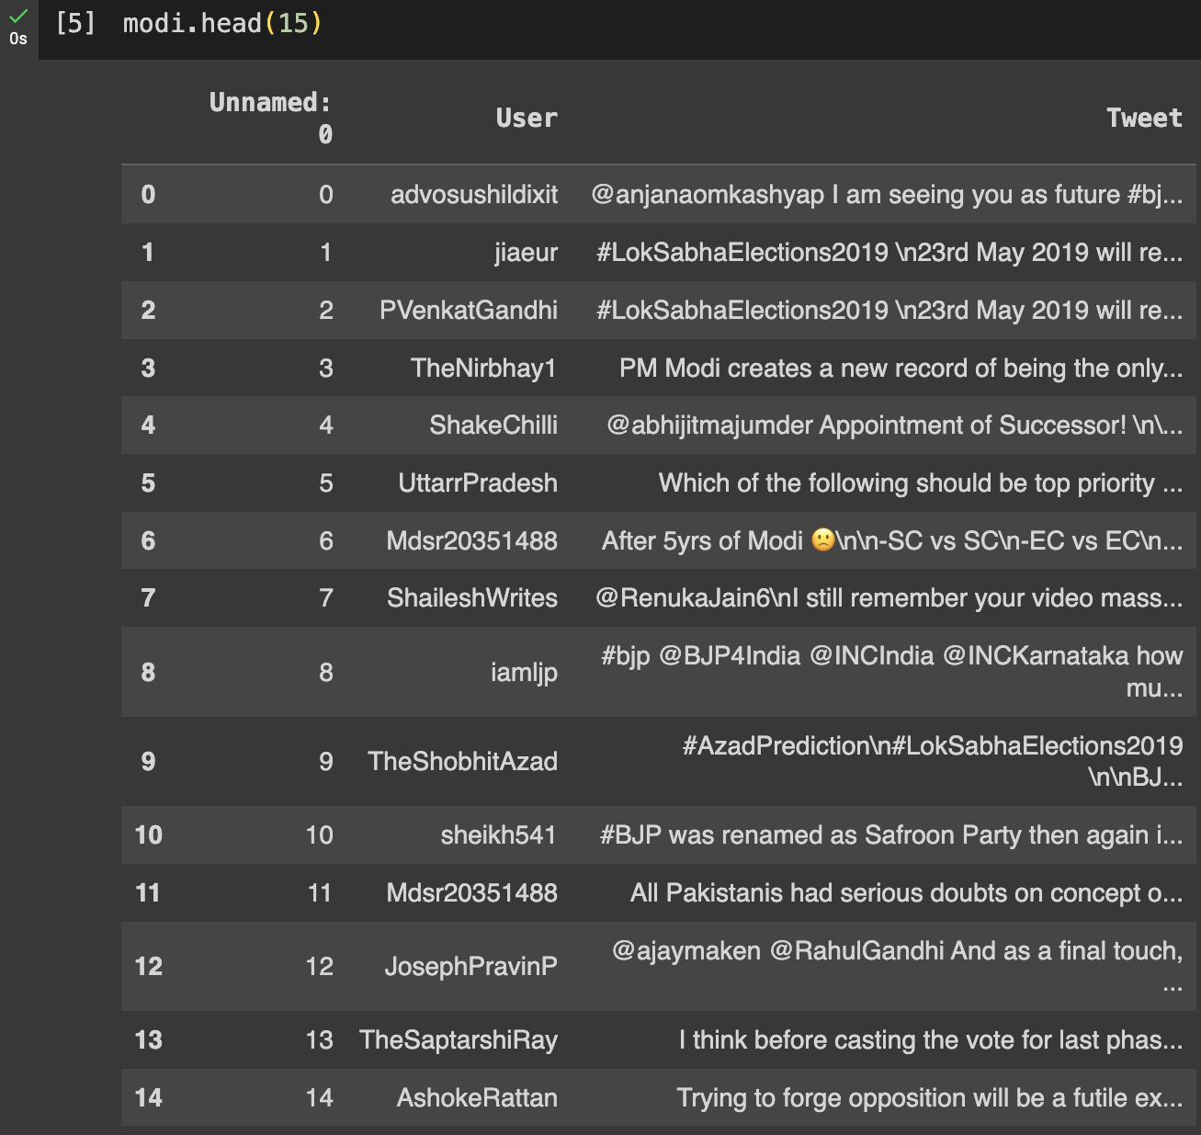
2.Inspecting Dataset

Slide 10
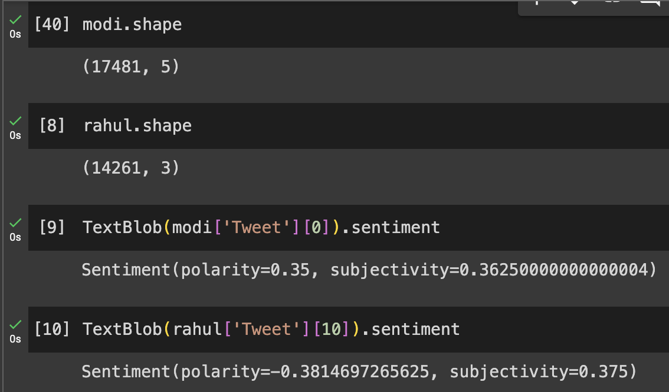
3. Fetching Sentiment Scores of the tweets
Module 2 – Sentiment Analysis

Slide 11
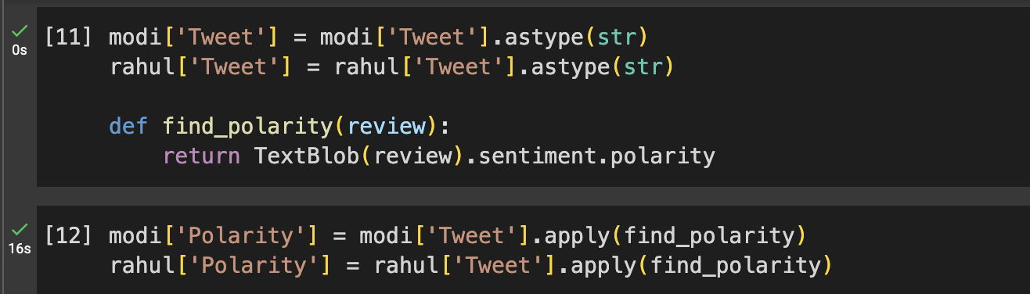
4. Generating the polarity of the tweets

Slide 12
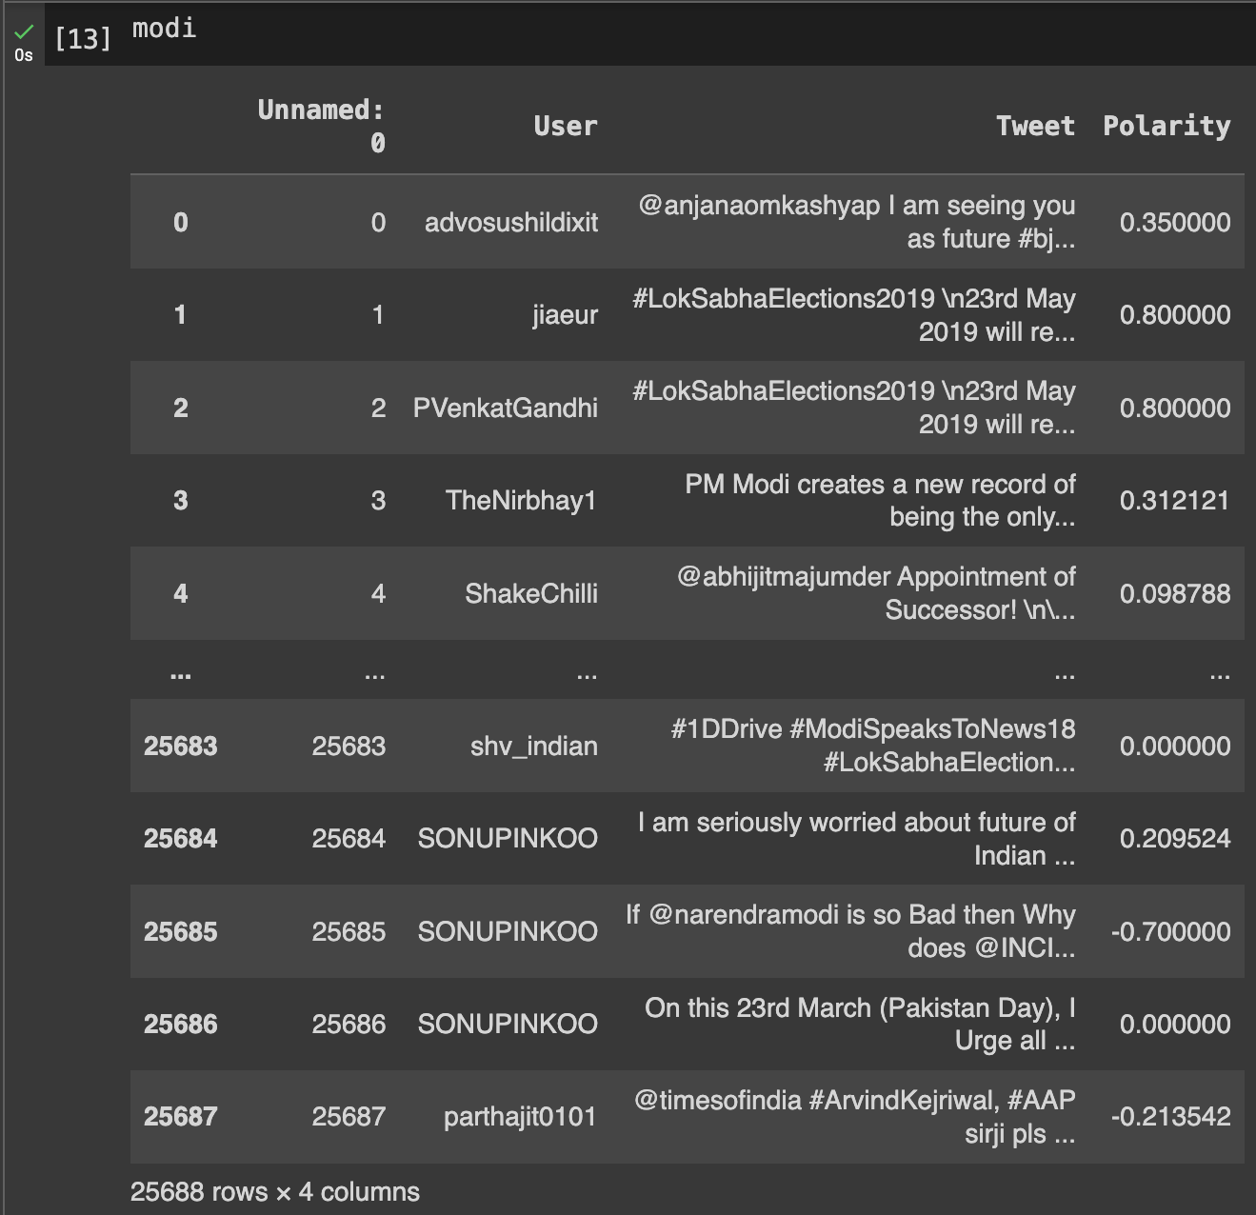
4. Generating the polarity of the tweets

Slide 13
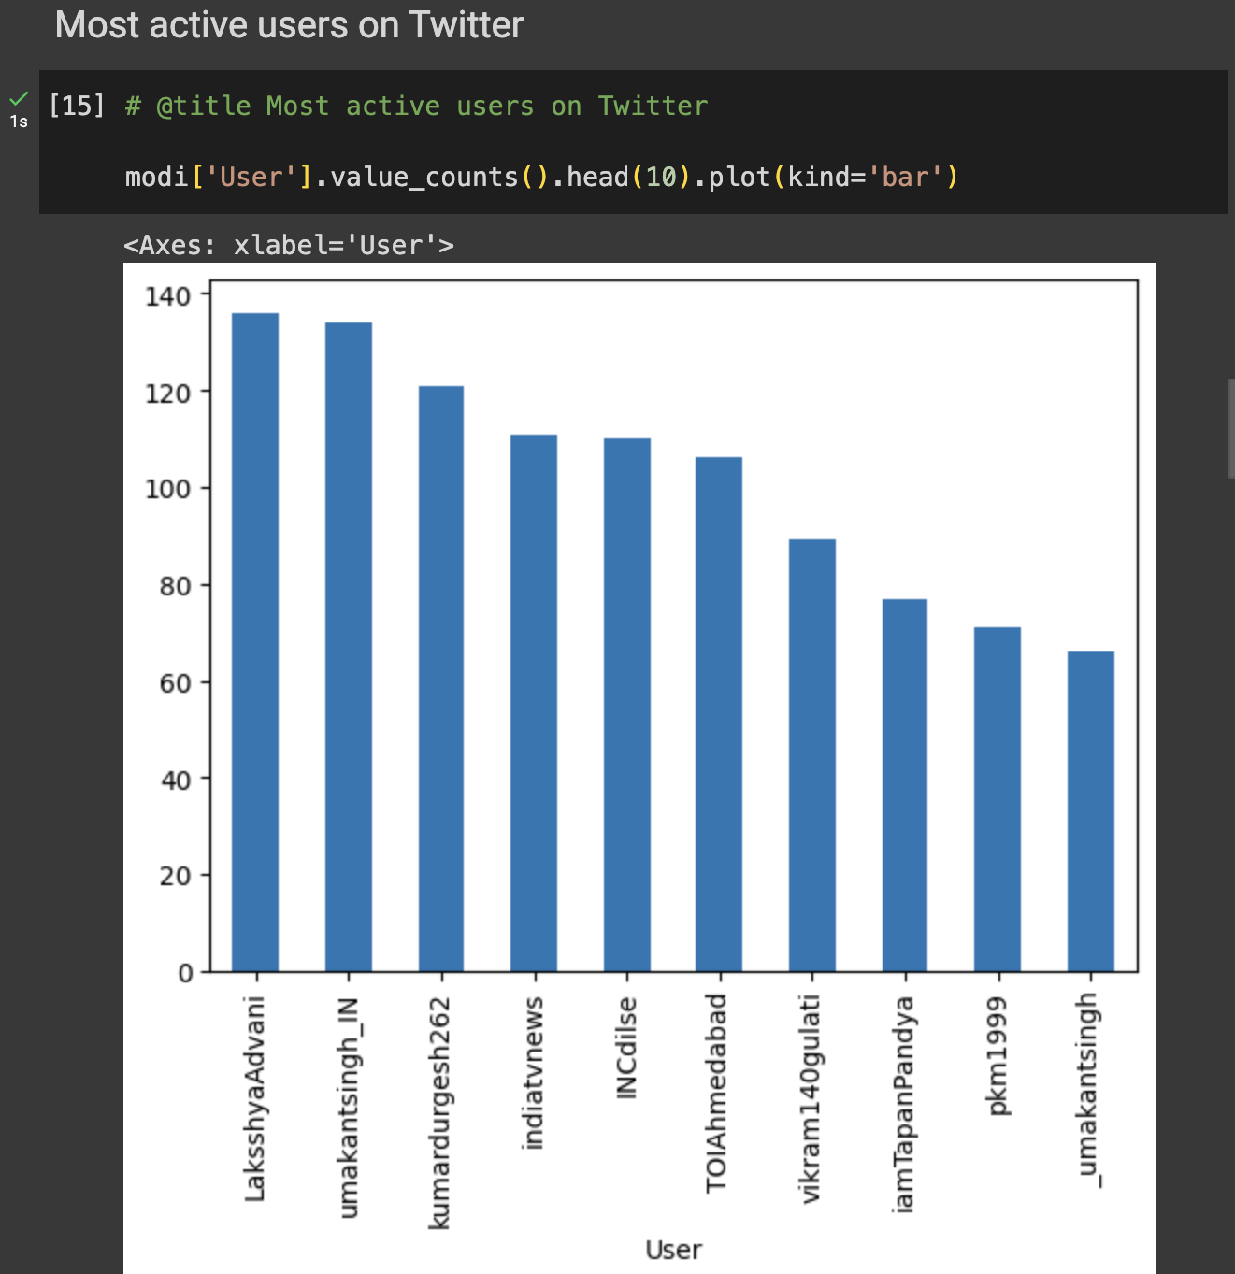
4. Generating the polarity of the tweets

Slide 14
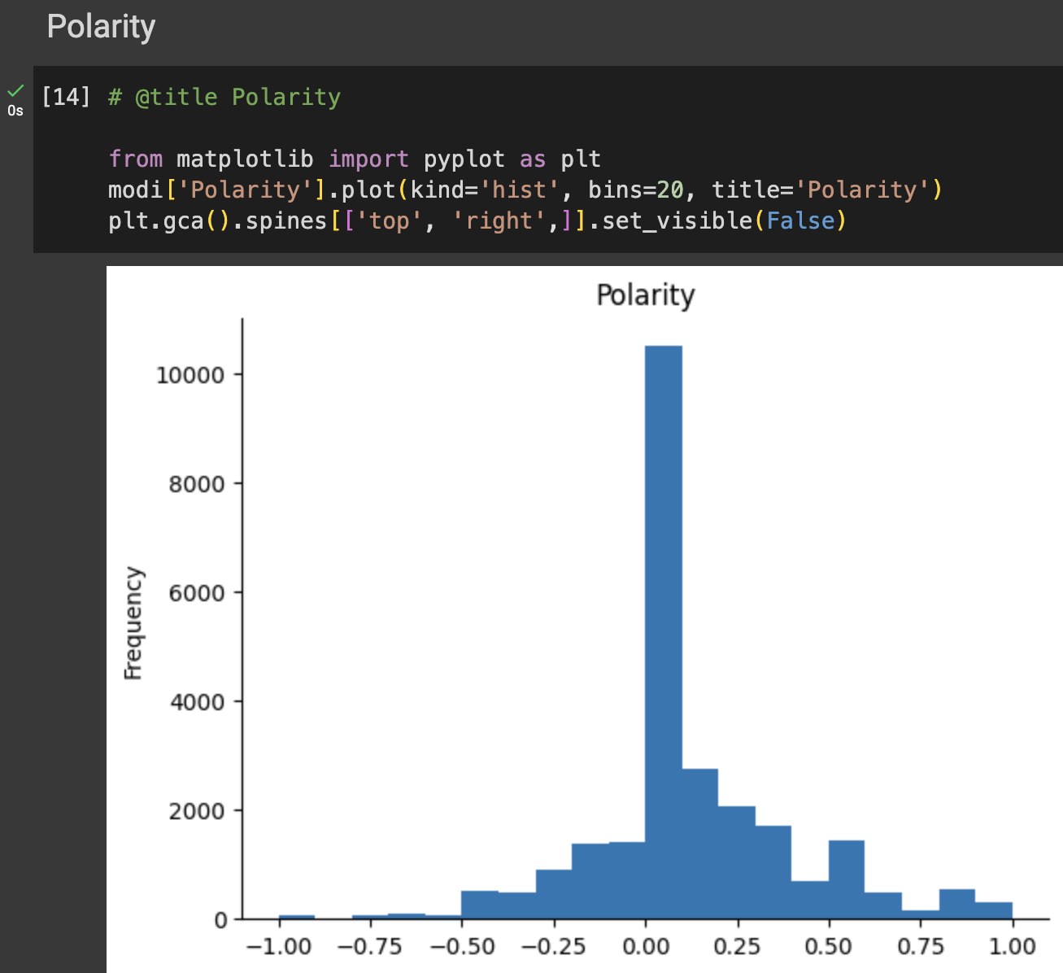
4. Generating the polarity of the tweets

Slide 15
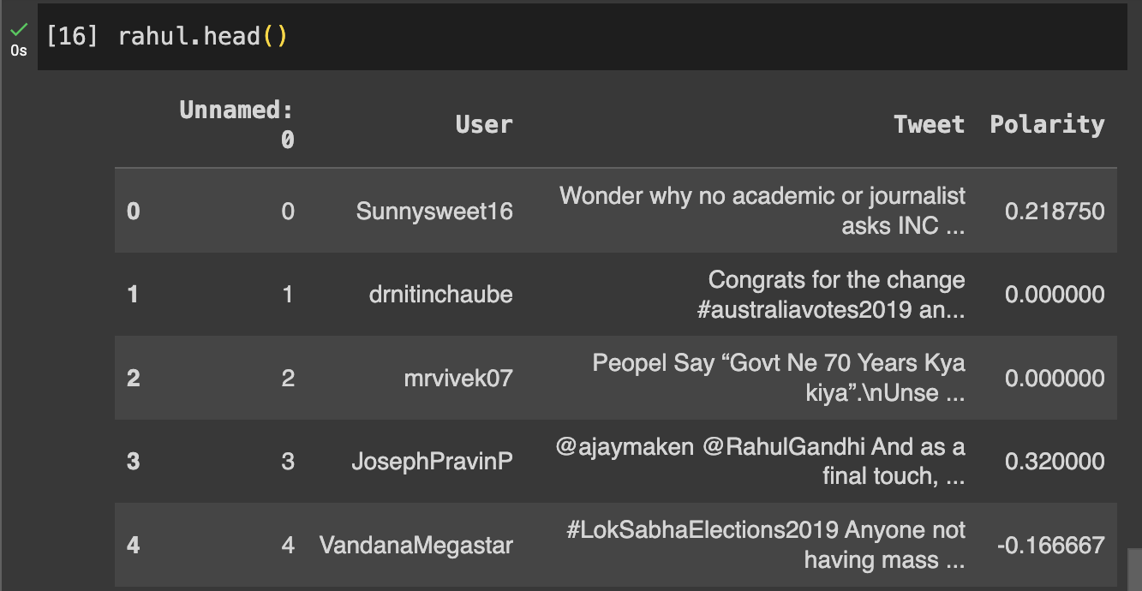
4. Generating the polarity of the tweets

Slide 16
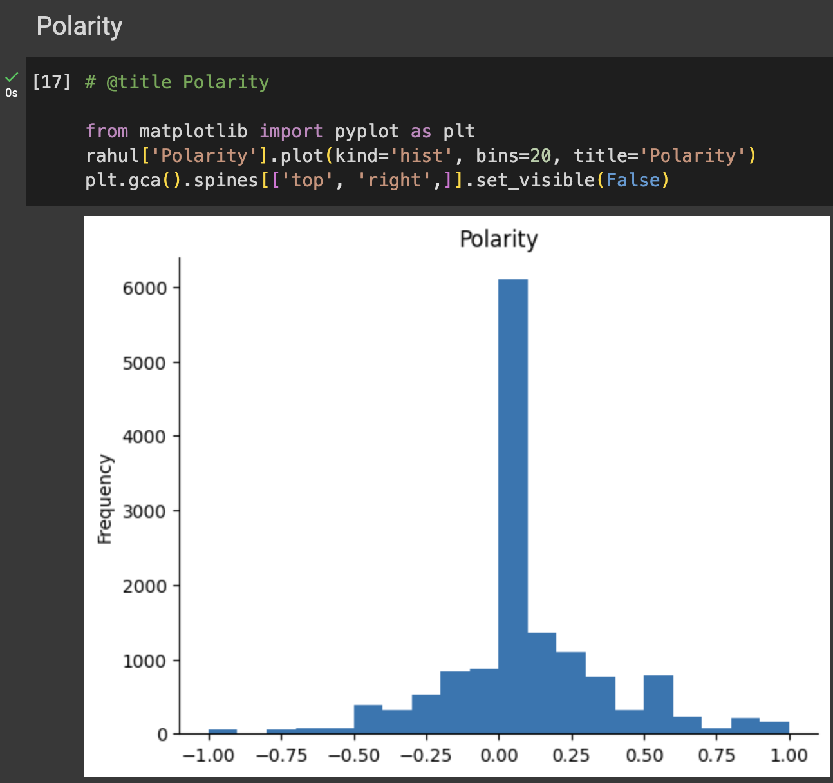
4. Generating the polarity of the tweets

Slide 17
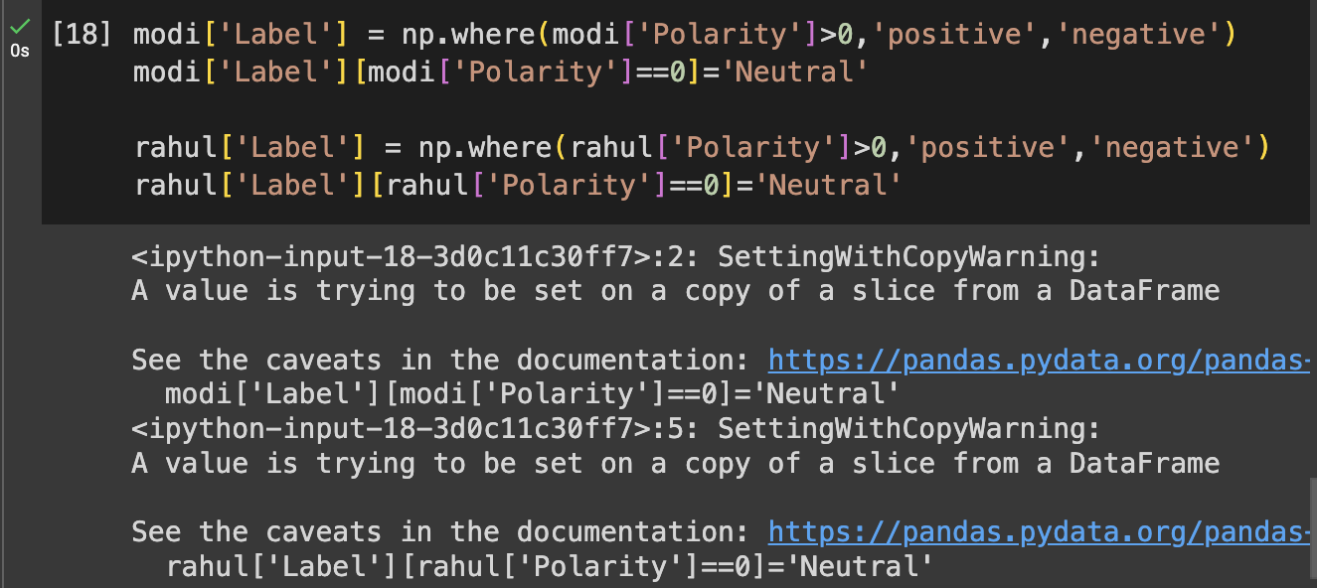
Module 3 – Polarity Mapping
5.Categorizing the tweets based on their polarity

Slide 18
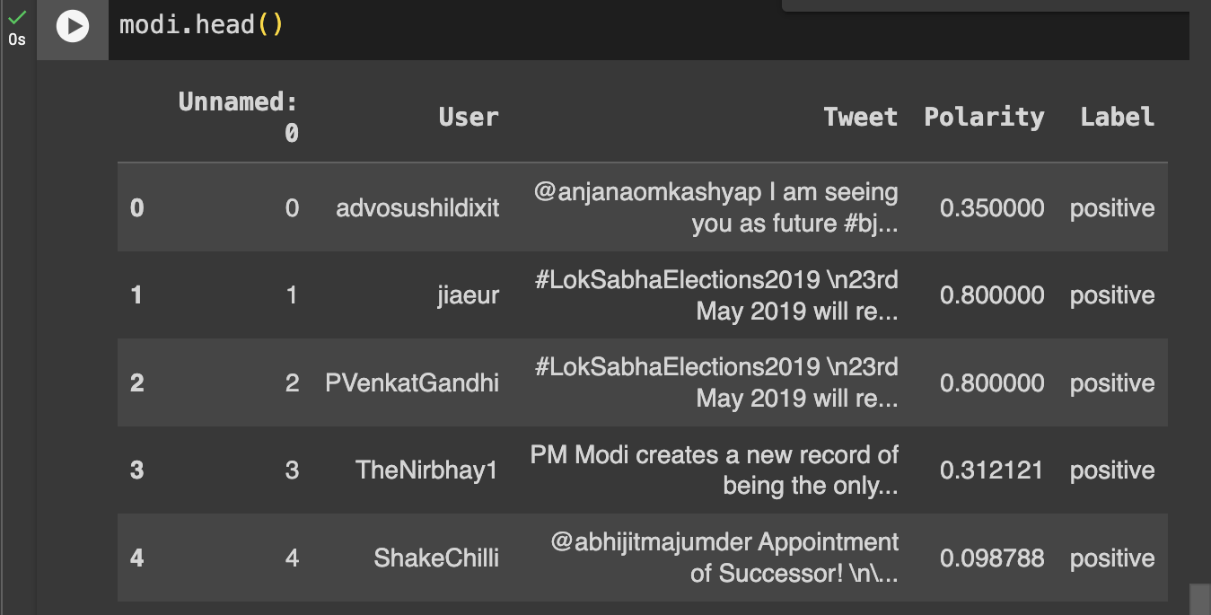
5.Categorizing the tweets based on their polarity

Slide 19
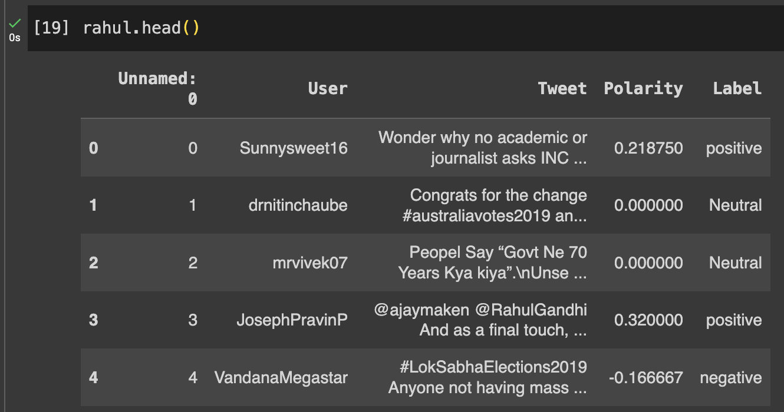
5.Categorizing the tweets based on their polarity

Slide 20
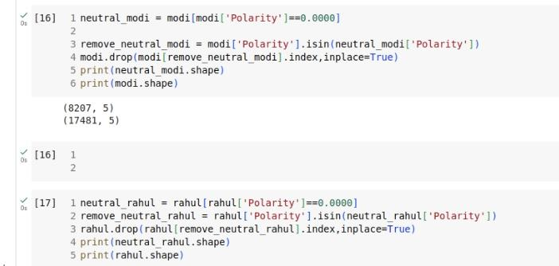
6.Removing Tweets with Neutral Polarity

Slide 21
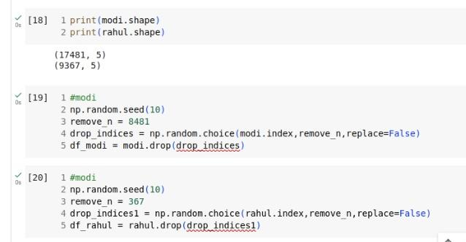
7.Droping the indices of the tweets with Neutral Polarity

Slide 22
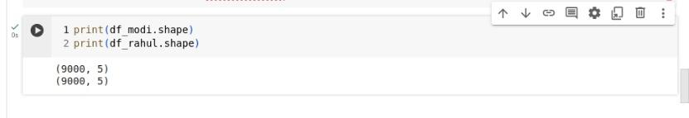
8.Final data set after removing neutral polarity tweets

Slide 23
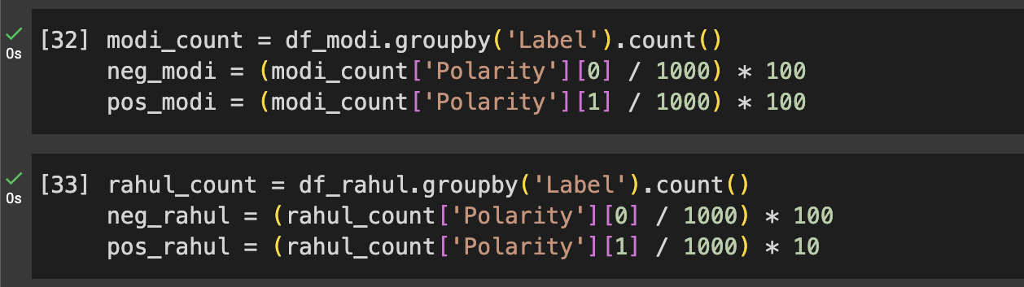
9.Prediction about Indian election
MODULE 4 - PREDICTION

Slide 24
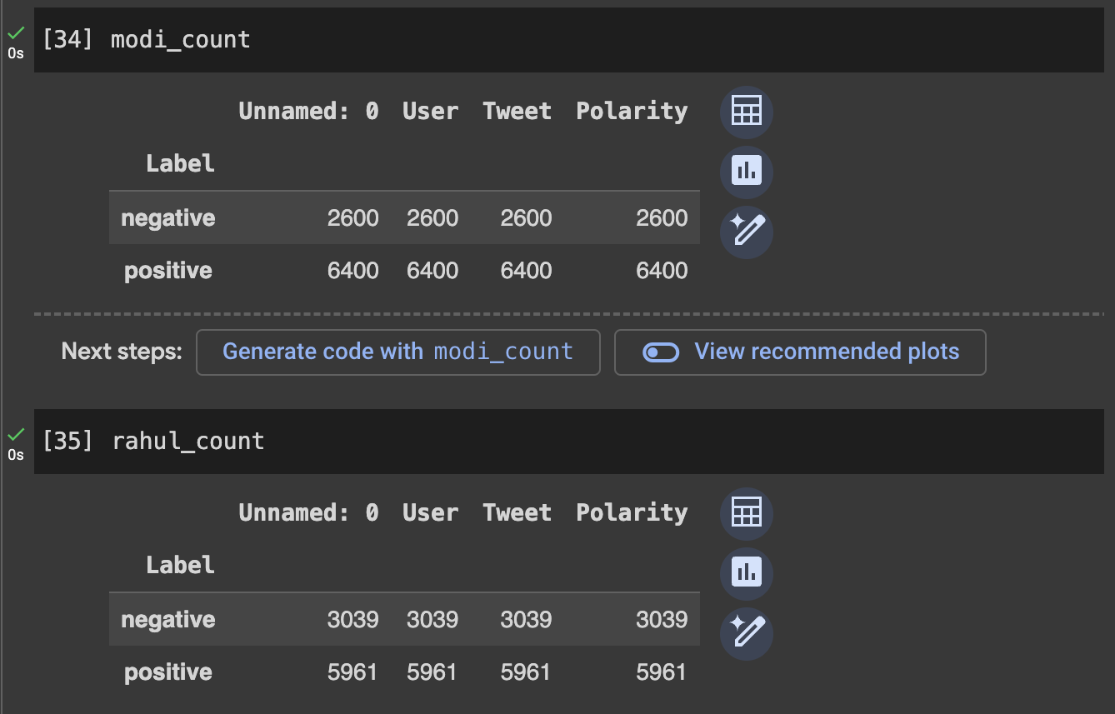
9.Prediction about Indian election

Slide 25
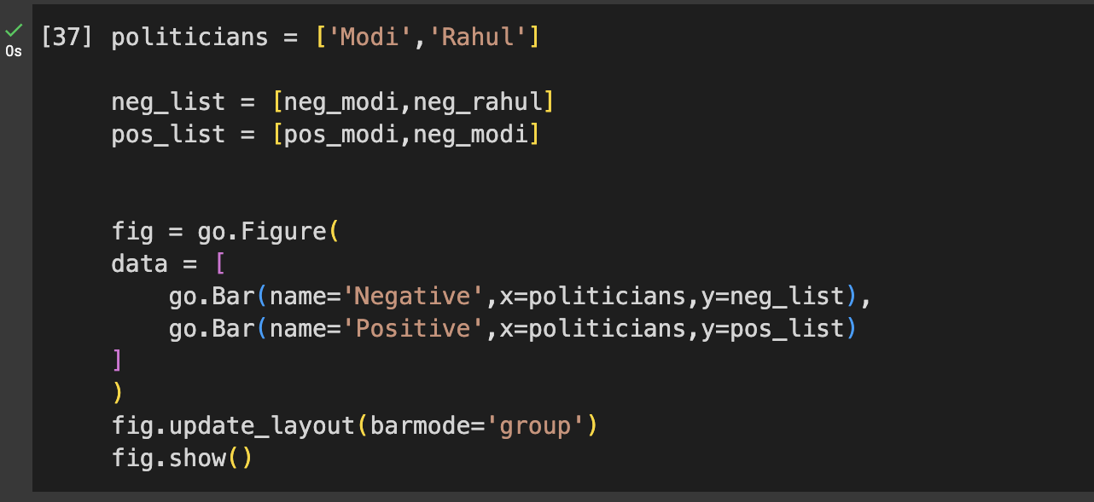
9.Prediction about Indian election

Slide 26
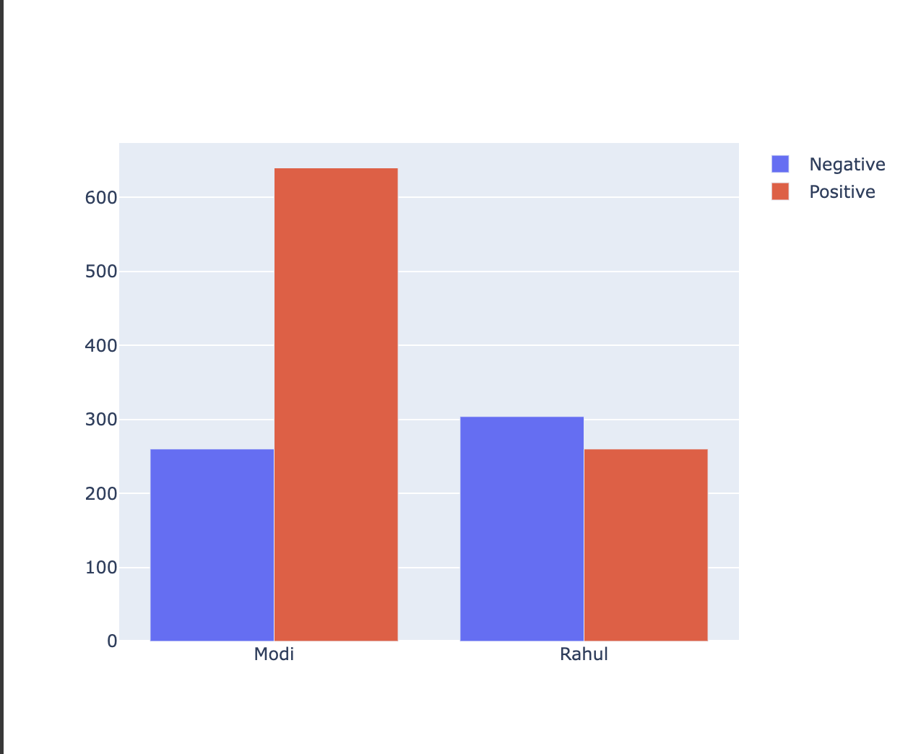
9.Prediction about Indian election

Slide 27
THANK YOU!

